Slide 1

ZOMATO RESTAURANT ANALYSIS - PROJECT
By : ROSHAN CHAWLA
Batch : MAY 2024

Slide 2
Contents of the Project
Analyzing Raw Data
Recommendation of Country(s) and City(s) for Opening of New Restaurants
Competition Analysis
Cuisine Analysis
Online Delivery vs Table Bookings
Correlation Between Rate of Cuisines and Ratings
Restaurants in Different Price Range
Dashboard

Slide 3
Analyzing Raw Data
01
Given the huge pile of data on Zomato Restaurant Business.
Microsoft Excel has been used to study the data and draw conclusions.
Used Various functions, formulas, techniques and tools within Microsoft Excel.
MyDelivery

Slide 4




Recommendations
02
BASIS FOR SELECTION
Less Competition
Ratings less than 4, meaning there is an opportunity to tap the market with selected cuisines and right pricing.
Countries Shortlist : AUSTRALIA, CANADA, SINGAPORE, SRI LANKA.

Slide 5
Shortlisted States/Cities within Suggested Counties
02
AUSTRALIA
Armidale,
Balingup,
Dicky Beach,
Flaxton,
Lorn,
Macedon,
Penola,
Victor Harbor
CANADA
Consort,
Yorkton
SINGAPORE
1. Singapore
SRI LANKA
1. Colombo

Slide 6
Average Rating v Suggested Counties
03
There is an immense opportunity to increase the count of restaurant as the ratings are between 3 and 4.
If we provide best quality food across high rated cuisines, we can tap these markets and side by side make them profitable as well.

Slide 7
Cuisine Analysis
04
Following cuisines are high rated ones in the suggested countries.
Meaning we cannot go wrong if we tap a less competitive market with these cuisines as it is most likely to take off.

Slide 8
Online Delivery vs Table Bookings
05
DELIVERY MODE ANALYSIS
Country | Online Delivery | Table Booking
Australia | 0 | 0
Canada | 0 | 0
Singapore | 0 | 0
Sri Lanka | 0 | 0
Suggested countries do not have online Delivery and Table Booking.
Solving the problem of easily ordering online and giving convenience of service by allowing the customers to book a Table in advance may be seen as First Mover Advantage.

Slide 9
Correlation between Rate of Cuisines and Ratings
06
R^2 = -0.003942111
Inverse correlation between Rates of Cuisine and Ratings.
Since R^2 is closer to 0 meaning the chances of reduction in Ratings is negligible if the rates of cuisines are increased.
R^2 definitely working in Favour ☺

Slide 10
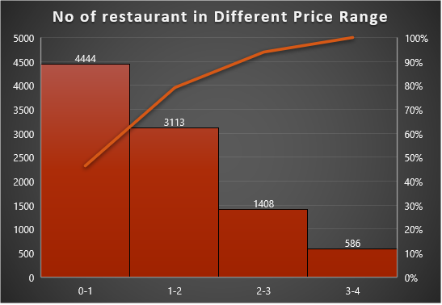
Restaurants in Different Price range
07
To understand the distribution of the number of restaurants of different price ranges in all the countries.
Used a Histogram with the trend line to illustrate the Price Range Distribution.

Slide 11
Key Findings
08
Identified countries with potential for new restaurant openings based on low competition and favorable ratings.
Recommended focusing on local cuisines while considering market preferences for menu planning.
Analyzed the distribution of restaurants across different price ranges to understand market dynamics.
Explored the impact of factors like online delivery and table bookings on customer satisfaction and market share.
Investigated the correlation between cuisine rates and customer ratings to optimize profitability.

Slide 12
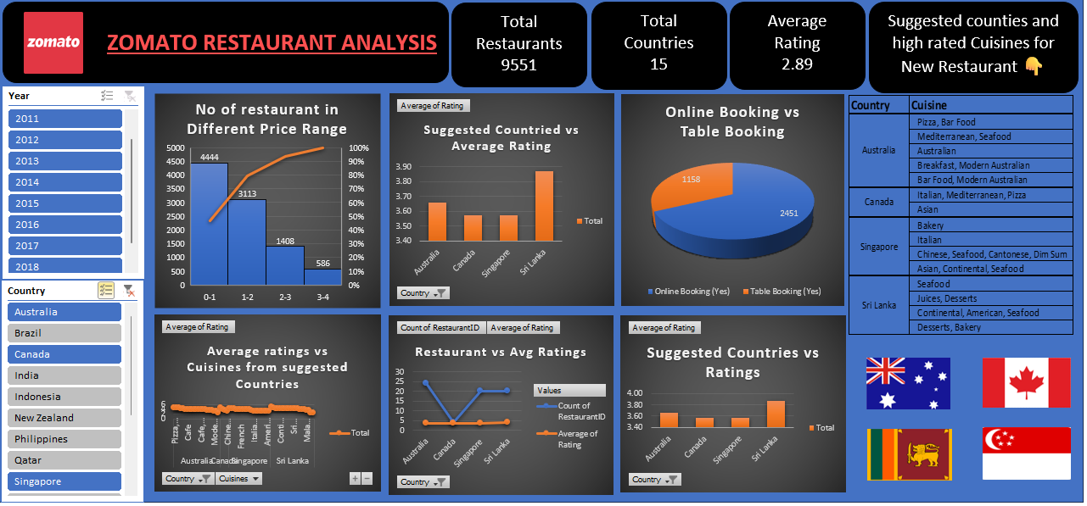
10 DASHBOARD

Slide 13
CONCLUSION
Through meticulous data analysis, we've identified promising opportunities for expanding Zomato's presence.
The selected countries and cities offer a balance of lower competition and favorable customer ratings.
Emphasizing local cuisines while considering market preferences can enhance the success of new restaurants.
Insights into online delivery, table bookings, and pricing dynamics provide valuable guidance for strategic decisions.
Continual monitoring and adaptation based on customer feedback and market trends are crucial for sustained growth.

Slide 14
08 DASHBOARD
THANK YOU

